Slide 1

Mobile Application Development, Fall 2021 In-App Authentication Part 1

Slide 2
Today’s Agenda
Quick Primer on Express and MongoDB
Setting Up Our New App
Navigator Hookups
Building the Authentication Screens
The Auth Context

Slide 3
Quick Primer on Express and MongoDB
So, we only have a couple days left!
We’re shifting gears into our final app! This app revolves around…
Users being able to sign up for our app and signing in…
And then because able to create “tracks” that represented “tracked” movement.
Basically, a track is a collection of points, where each point represents one location in the world.

Slide 4
Quick Primer on Express and MongoDB
To facilitate this, lots of stuff has been handed to you.
I understand that this is a bunch of code that I’m asking you to “just use” which can feel a little unsettling.
But the main things that you can read up on for more info is MongoDB and Express
https://www.mongodb.com/cloud
http://expressjs.com/

Slide 5
Quick Primer on Express and MongoDB
MongoDB is a mechanism to set up databases!
As we saw in the last slide deck: databases are tools for storing information that enables persistence in our apps.
MongoDB is cool for a couple of reasons:
It is relatively easy to set it up in the cloud!
So that the data isn’t tied to any one device.
The formatting of the data is basically JSON
i.e., it will make it pretty easy for our apps to give data to---and receive data from---the database.

Slide 6
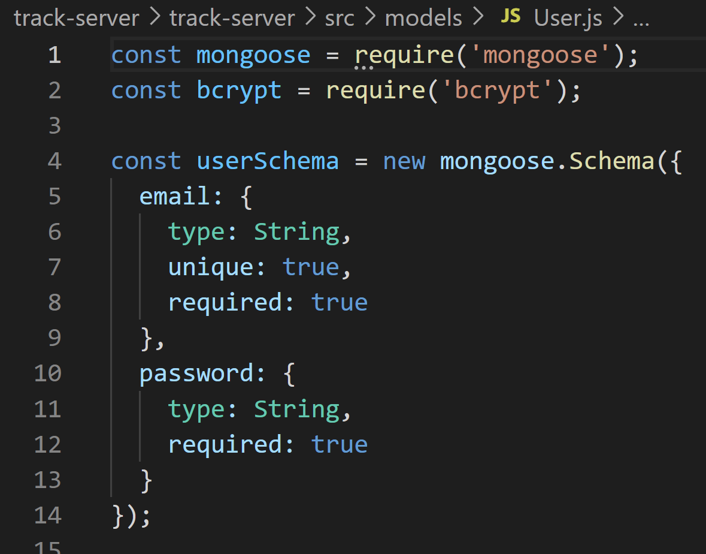
Quick Primer on Express and MongoDB
We define the structure of the data that we are going to be storing in our database with a “schema”
Here, in User.js, we define that each User in our database should have…
An e-mail, stored as a string
A password, stored as a string.
Note: an “id” field will be generated for us automatically as well.
User.js

Slide 7
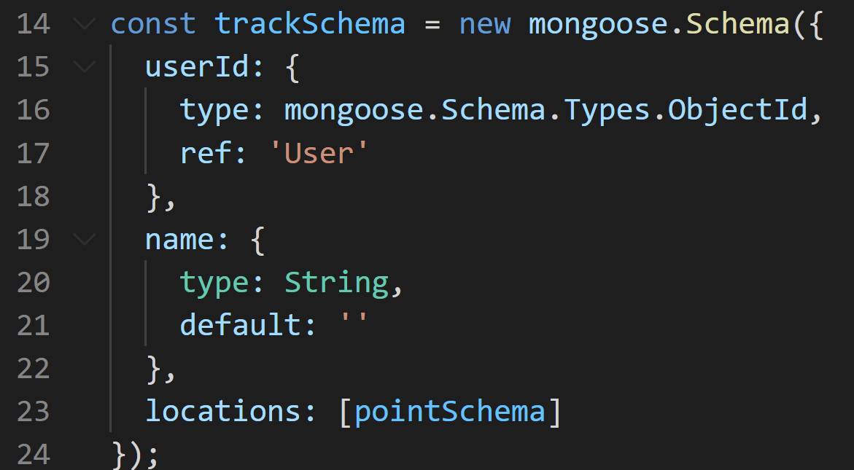
Quick Primer on Express and MongoDB
Likewise, a Track is defined by its own schema.
A track has…
a userID
Which we are saying here should match with IDs from the User schema.
a Name
Which is a string, default to be empty.
And locations
Which is an array of “pointSchemas” – basically objects.
Track.js

Slide 8
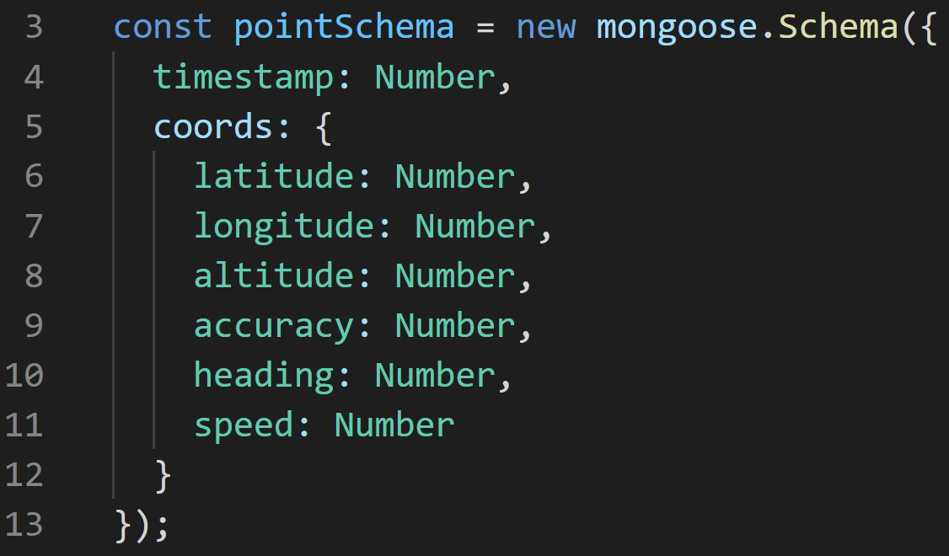
Quick Primer on Express and MongoDB
And in that same file, we define just what a pointSchema even is!
A point schema has a timestamp and then an additional cords object
The timestamp is going to be some long number – the number of milliseconds since 1970!
The coords object has coordinate information. latitude, longitude, etc.
This will come from our phone telling us the location of the user!
Track.js

Slide 9
Quick Primer on Express and MongoDB
Express is a “web application framework.”
Remember how we set up the JSON server last time?
And it had various things kind of built in already?

Slide 10
Quick Primer on Express and MongoDB
For each “resource type” we could GET all of them or one of them, we could POST a new one, PUT an edit on an existing one, or DELETE an existing one.
Method
Route
Result
GET
/blogposts
Retrieve all stored blog posts
GET
/blogposts/{id}
Get blog post with particular ID
POST
/blogposts
Create a new blog post.
PUT
/blogposts/{id}
Update blog post with given ID
DELETE
/blogposts/{id}
Delete blog post with given ID

Slide 11
Quick Primer on Express and MongoDB
That’s cool and great and all, but what if we wanted to do something a little custom?
Method
Route
Result
GET
/blogposts
Retrieve all stored blog posts
GET
/blogposts/{id}
Get blog post with particular ID
POST
/blogposts
Create a new blog post.
PUT
/blogposts/{id}
Update blog post with given ID
DELETE
/blogposts/{id}
Delete blog post with given ID

Slide 12
Quick Primer on Express and MongoDB
That’s where Express comes in, where you can define as many routes as you want, and specify what happens in them.
In the starter code you’ve been given, it includes the following routes.
Method and Route
Express API
POST
/signup
{email: string, password: string}
POST
/signin
{email: string, password: string}
GET
/tracks
POST
/tracks
{name: string, locations: [location]}

Slide 13
Quick Primer on Express and MongoDB
/signup takes in an e-mail and password, salts and hashes the password, and adds it to the database.
/signin takes in an e-mail and password, and verifies that they match a user we have in the database already.
GET /tracks and POST /tracks let’s us read and add to the user’s “track” data.
Method and Route
Express API
POST
/signup
{email: string, password: string}
POST
/signin
{email: string, password: string}
GET
/tracks
POST
/tracks
{name: string, locations: [location]}

Slide 14
Quick Primer on Express and MongoDB
This is stuff that is basically already given to you in the starter code.
The “track-server” file.
Method and Route
Express API
POST
/signup
{email: string, password: string}
POST
/signin
{email: string, password: string}
GET
/tracks
POST
/tracks
{name: string, locations: [location]}

Slide 15
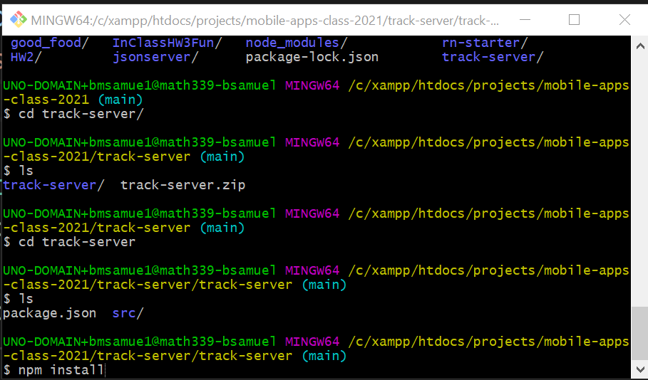
Quick Primer on Express and MongoDB
So, with that very high level introduction discussed…
If you open up a terminal, and go to wherever you downloaded and unzipped the starter code…
specifically: the directory level that has package.json…
And then type in “npm install”…

Slide 16
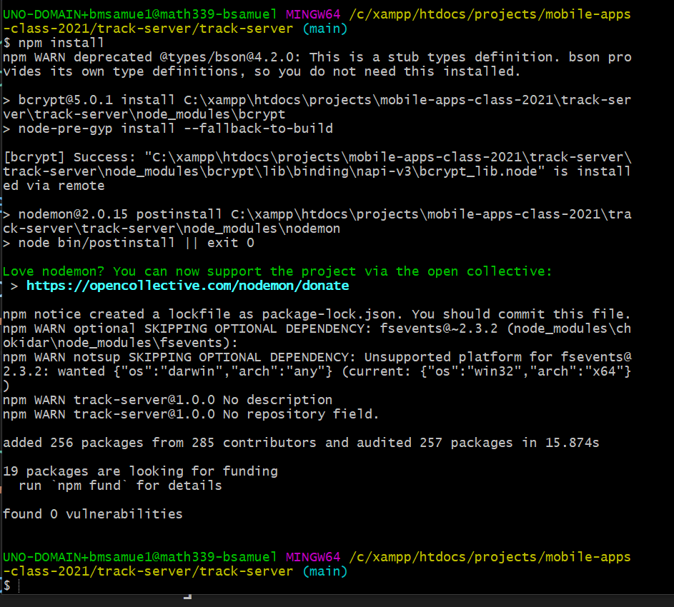
Quick Primer on Express and MongoDB
You should hopefully see something like this!
So you should now have a bunch of dependencies set up.

Slide 17
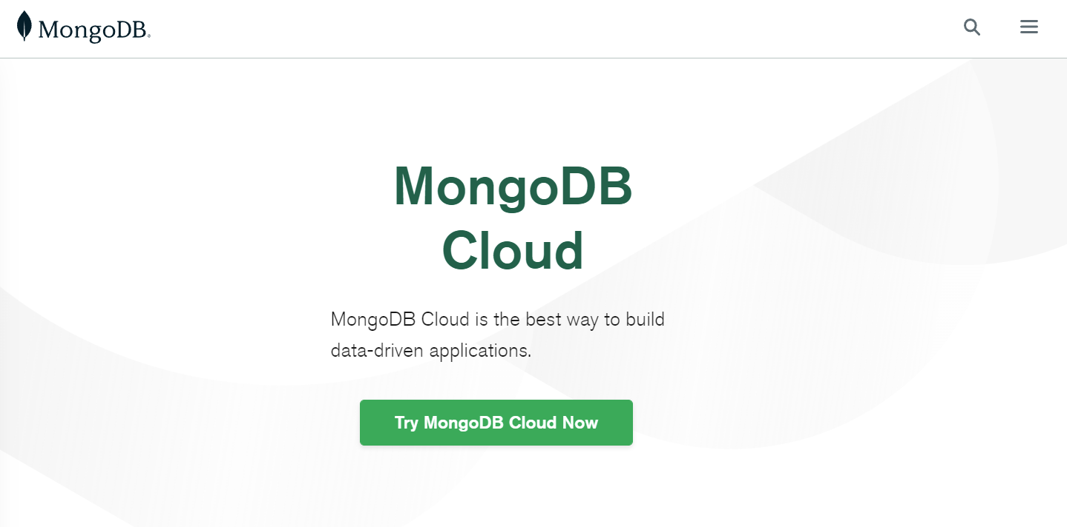
Quick Primer on Express and MongoDB
The next step is to set up a MongoDB Instance.
To do that, navigate to cloud.mongodb.com
And look for a “Free cloud hosting instance”

Slide 18
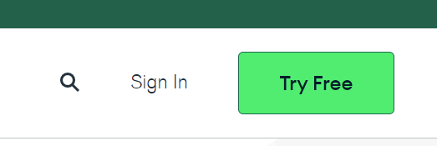
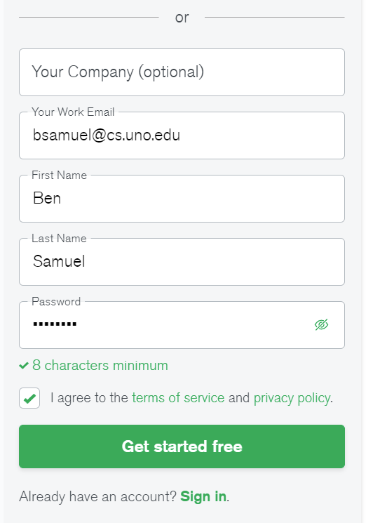
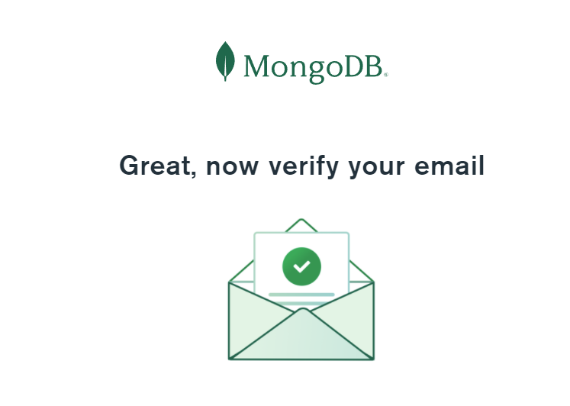
Quick Primer on Express and MongoDB
You’ll need an account, so if you don’t have one yet… click the “Try Free” button…
Fill in your info…
Verify your email…
(when I did this, I got weird e-mails making it sound like the link had expired… but I just signed in anyway and it worked fine).
And then sign in

Slide 19
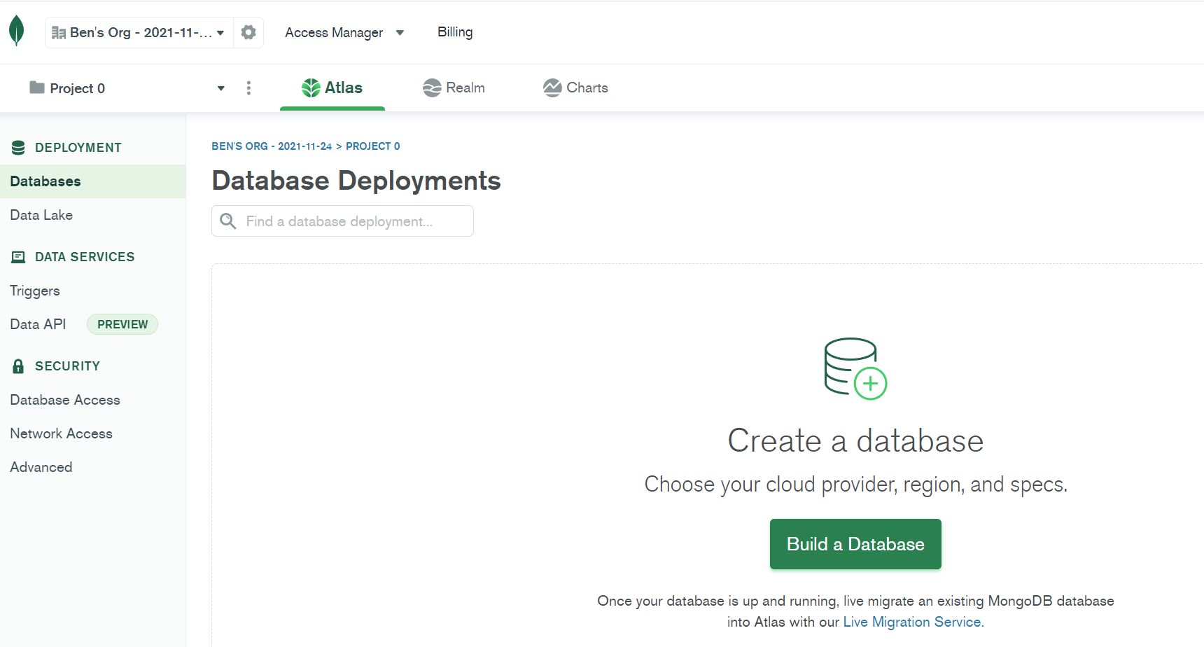
Quick Primer on Express and MongoDB
When you do, you’ll probably see something that looks like this!
You’ll want to look for something that says “Create a Cluster” or “Build a Database”

Slide 20
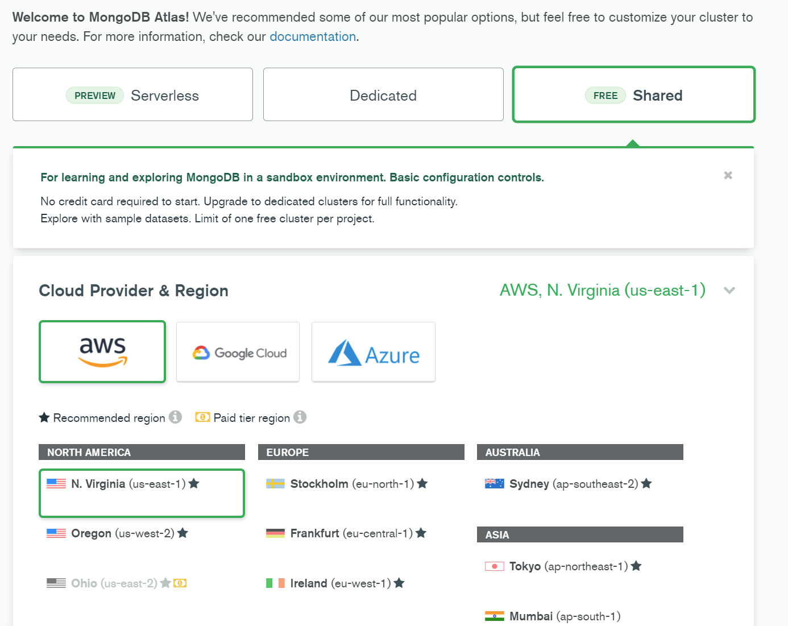

Quick Primer on Express and MongoDB
And you’ll get to a page that looks like this.
First, you’ll have to choose a provider.
AWS
Google Cloud
Azure
All are fine, pick whatever!

Slide 21

Quick Primer on Express and MongoDB
The more important thing is to pick a region that is free, and ideally relatively close to us.
N. Virginia isn’t too far away!

Slide 22
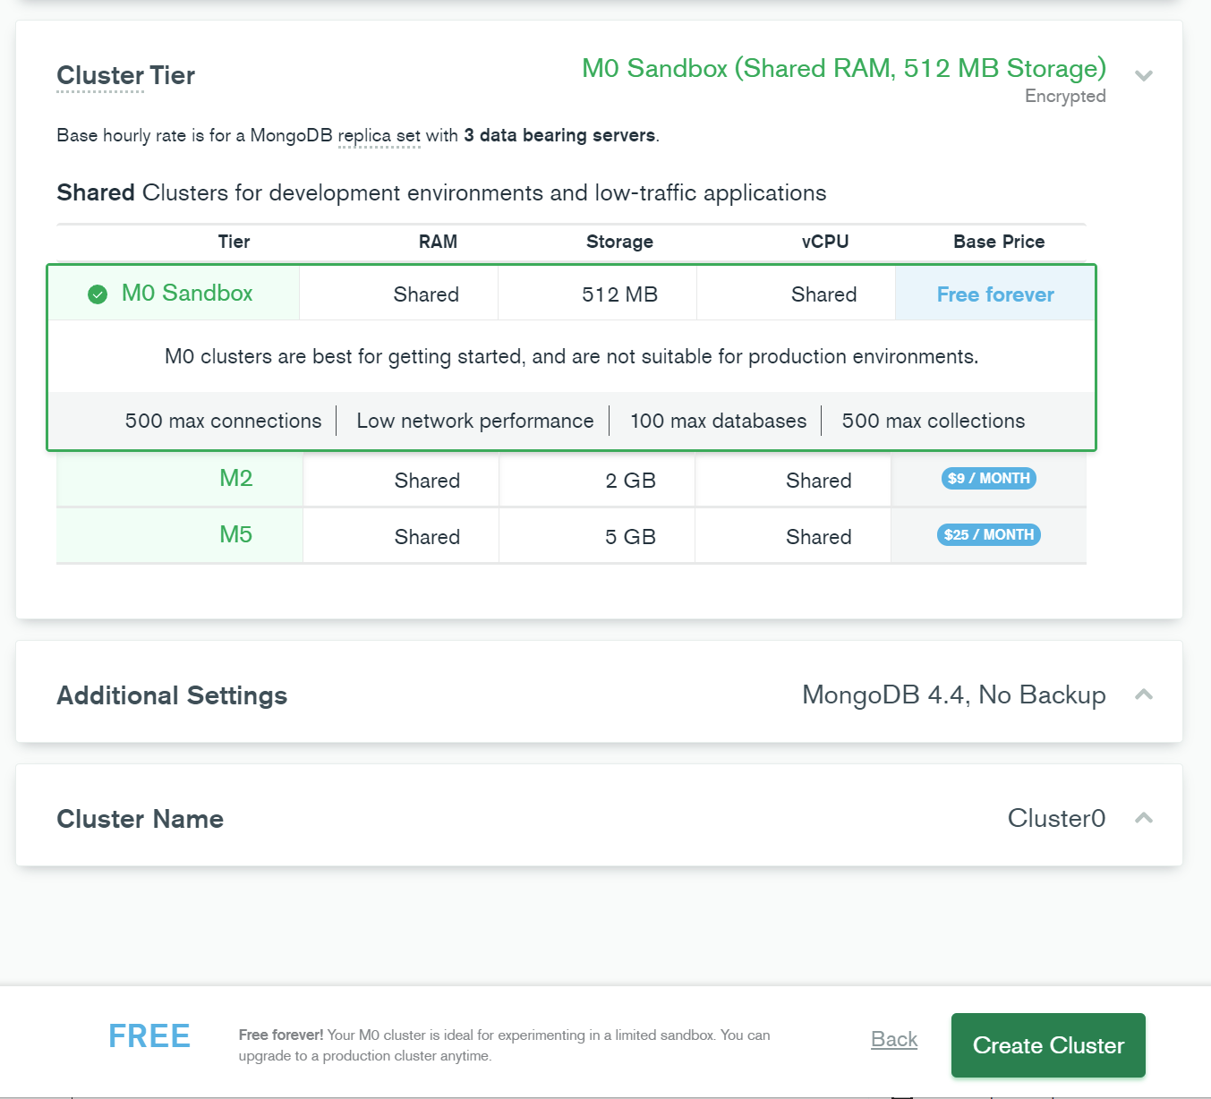


Quick Primer on Express and MongoDB
And you can scroll down and confirm in your Cluster Tier that it is indeed free!
Once you’ve done so, click the Create Cluster button!

Slide 23
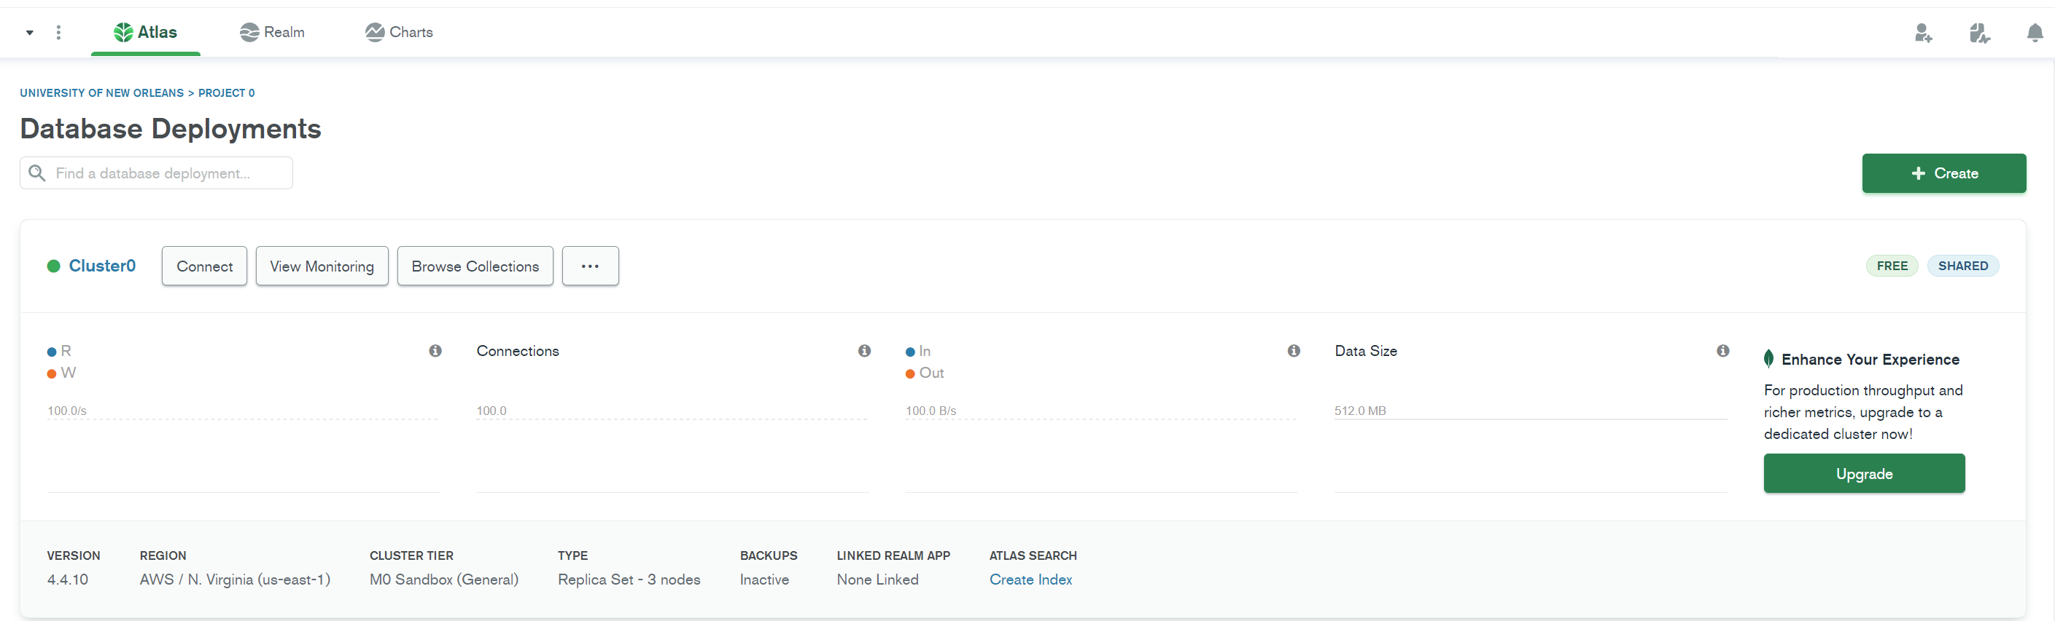
Quick Primer on Express and MongoDB
It’ll take a few minutes for the cluster to get set up…
And you may have to provide it with a user name/password / IP address…
But eventually you should see something like this.

Slide 24
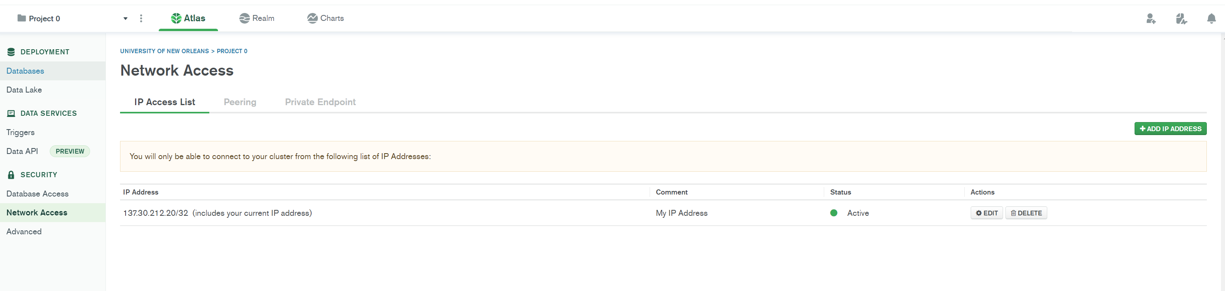


Quick Primer on Express and MongoDB
We’re going to very quickly make a change that will enable us to access MongoDB from any computer…
Click on Network Access…
Click on Add IP Address…

Slide 25
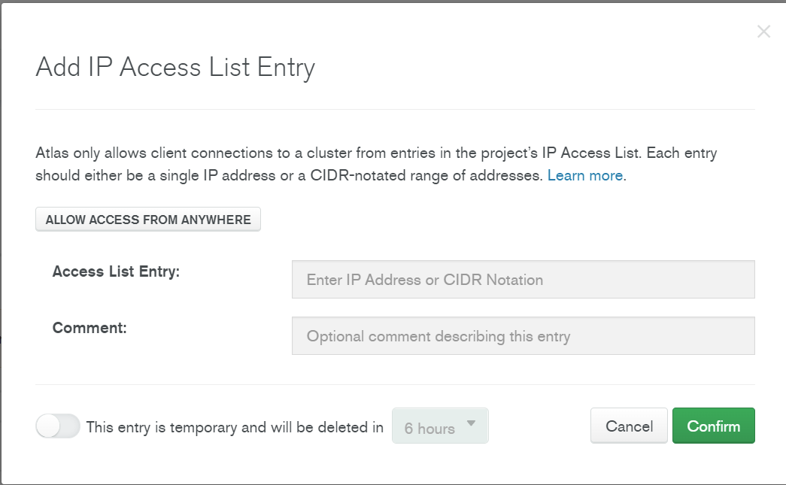


Quick Primer on Express and MongoDB
And then click “Allow Access from Anywhere” in the window that pops up.
And then hit Confirm.
Doing this, you won’t have to whitelist your IP.
Otherwise you would need to whitelist every computer/network you ever use!

Slide 26
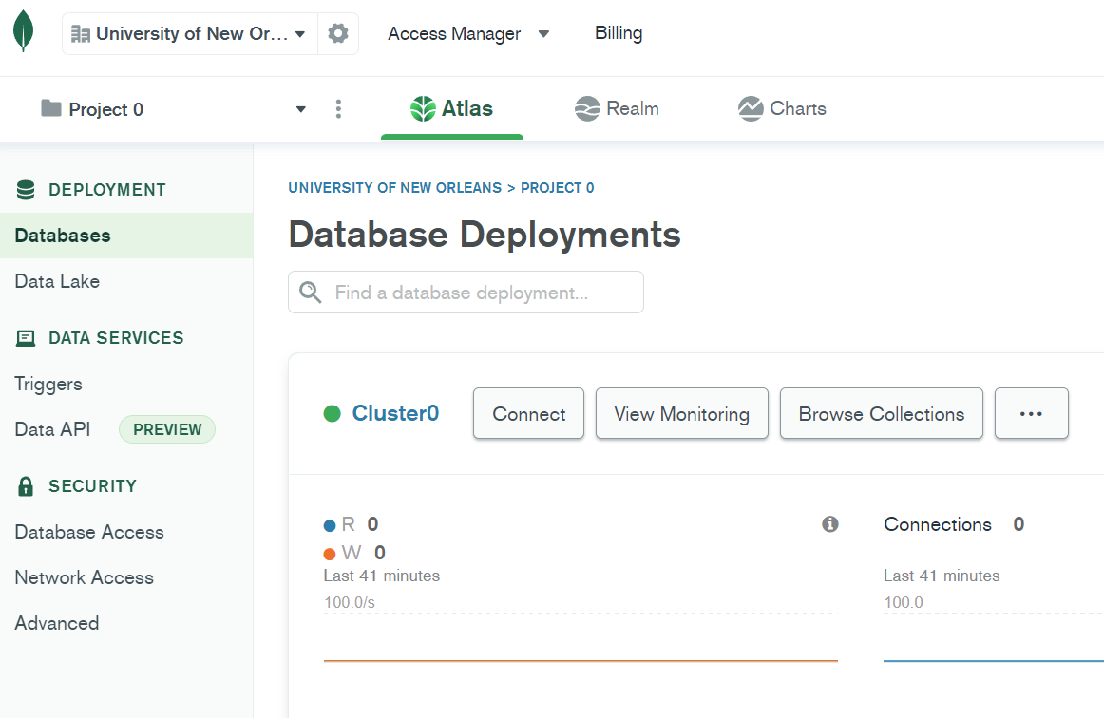


Quick Primer on Express and MongoDB
OK, back to here, (by pushing on the “Databases” button on the left).
we’ll click on Connect again.

Slide 27
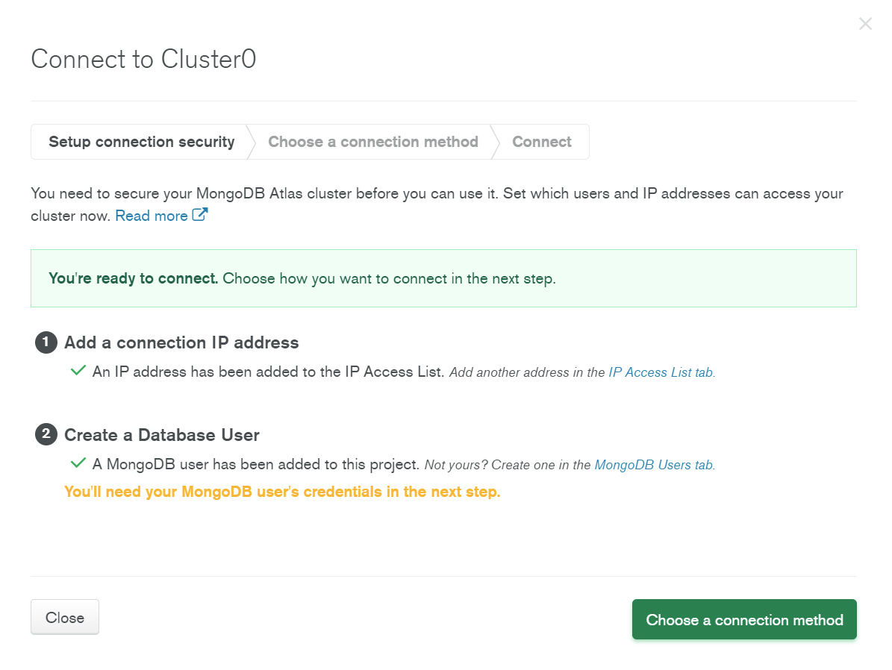
Quick Primer on Express and MongoDB
And it opens up the connection wizard.
By this point, your IP address should be taken care of.
You now need to create a Database user.
This should be different credentials than your MongoDB credentials.
For now, it can be something very simple.

Slide 28
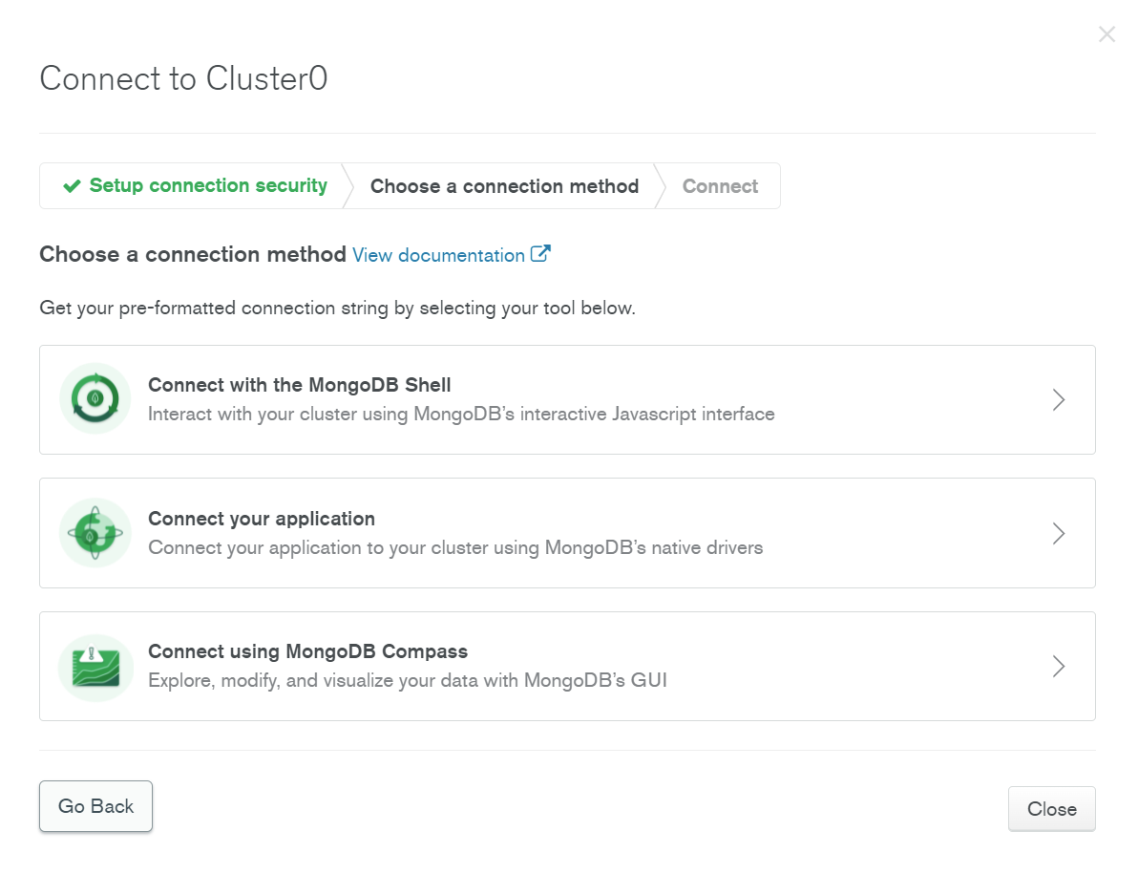

Quick Primer on Express and MongoDB
Next, you’ll have to “choose a connection method.”
We’re going to click on “Connect Your Application”

Slide 29
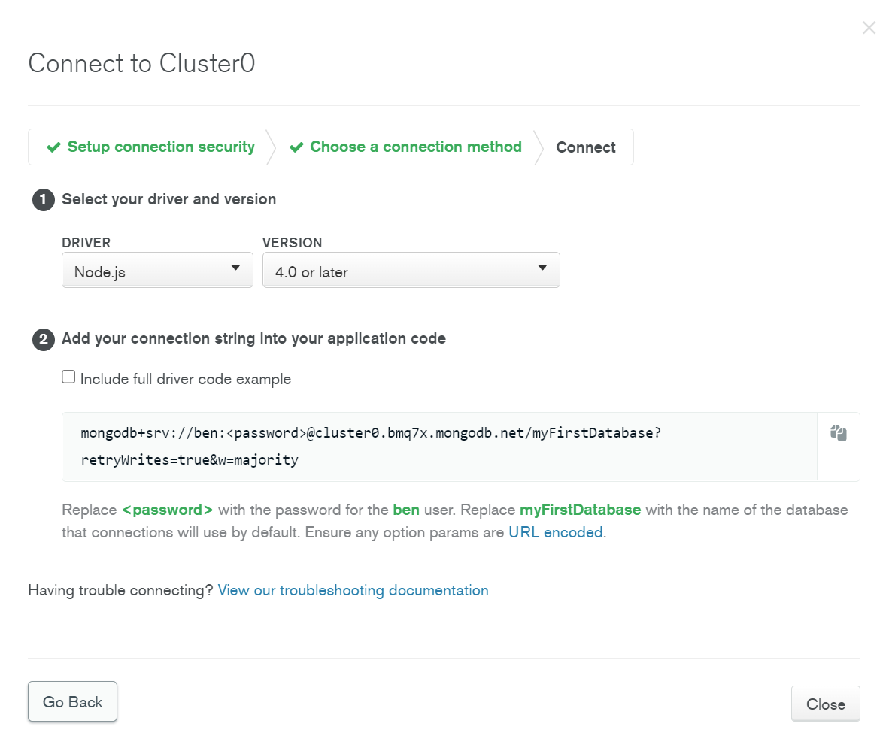

Quick Primer on Express and MongoDB
And you’ll see a new screen with a big string in the middle.
That’s the string we care about. We’ll copy it, and paste it into our code editor in just a second.

Slide 30
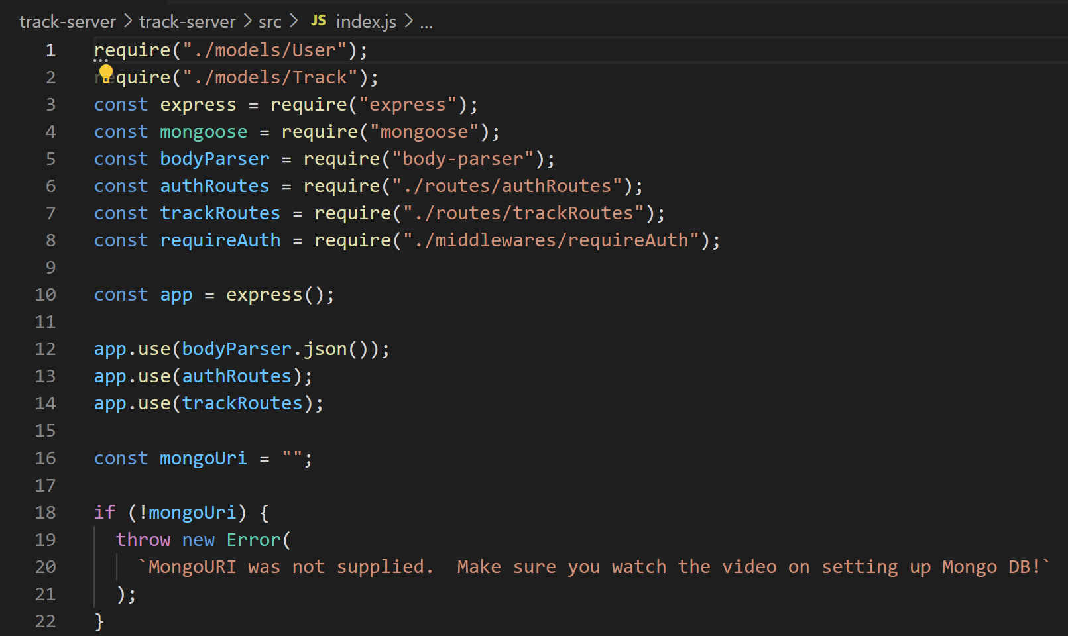

Quick Primer on Express and MongoDB
In the track-server .zip file you were given…
If you open up the src/index.js file…
On line 16…
You should see a variable called mongoUri that is currently an empty string.

Slide 31
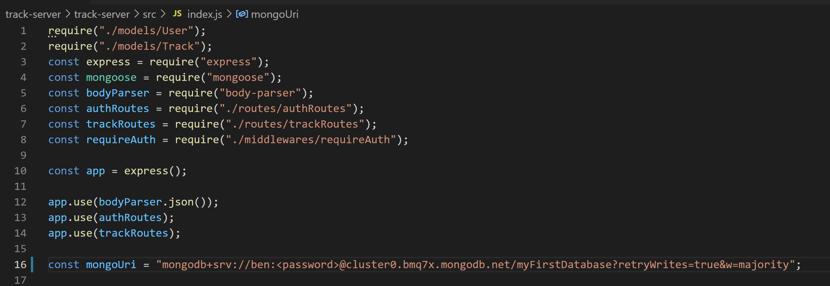

Quick Primer on Express and MongoDB
And so I just pasted that string.
You can see I made my user name “ben”, you can see it right here.
And note that there is a placeholder for your password…
It is time to enter in the password you made when creating your database user.
Again: this is *DIFFERENT* from your MongoDB account credentials.

Slide 32
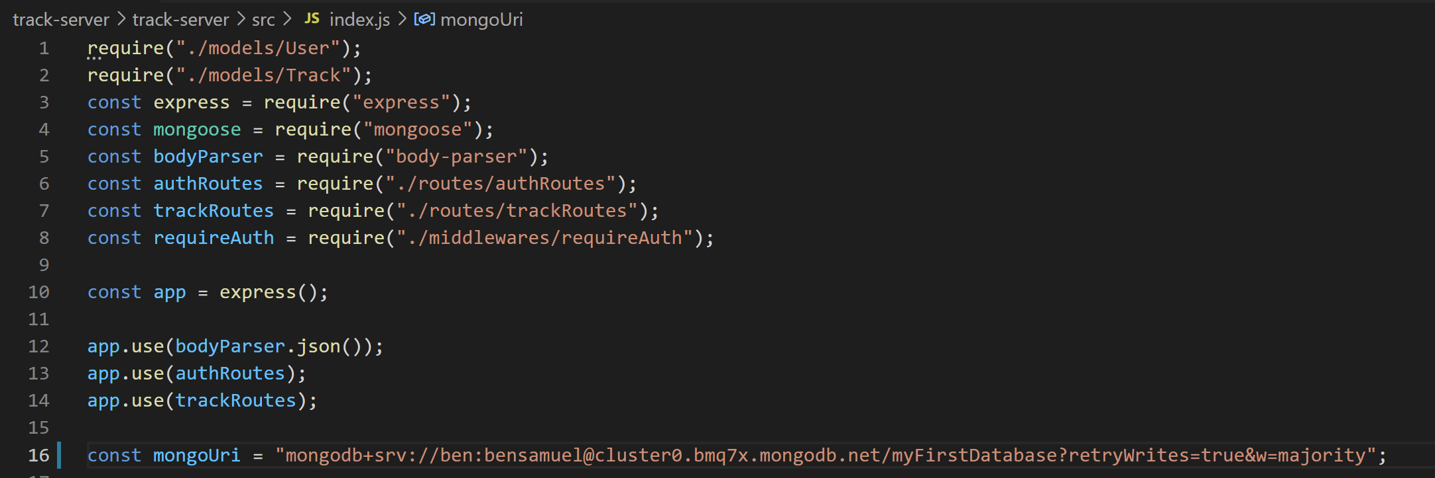
Quick Primer on Express and MongoDB
As promised, my password is something very silly right now.
But once we do that, we should now have everything in place for our server to be able to talk to mongodb!
Now it is just a matter of setting up our server!

Slide 33
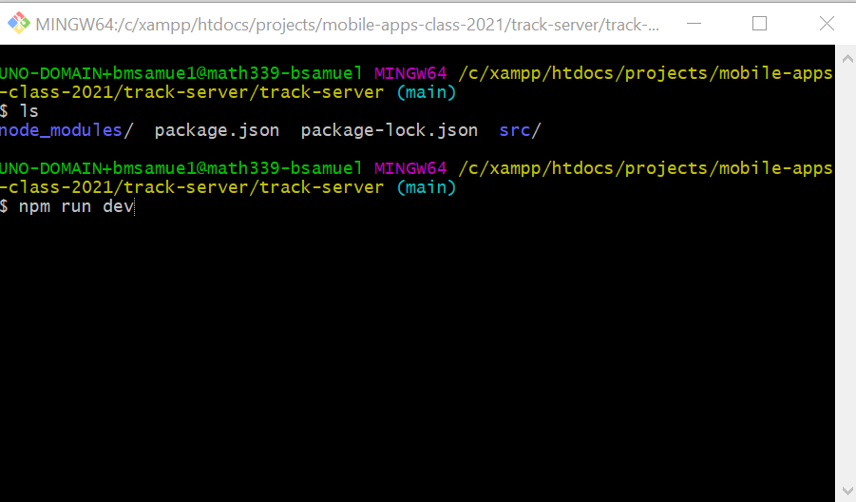
Quick Primer on Express and MongoDB
In a terminal, navigate to the root of the track-server code that you were given (the directory that has package.json in it)…
And type the following command:
npm run dev

Slide 34
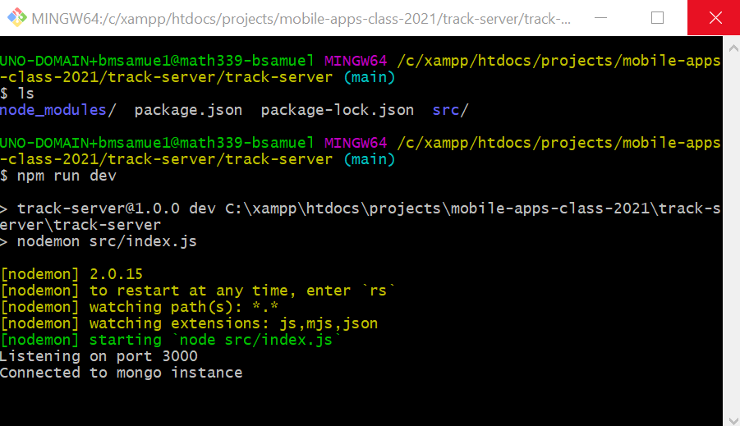
Quick Primer on Express and MongoDB
And you should hopefully see things that look like this!
Listening on port 3000!
Connected to mongo instance!

Slide 35
Quick Primer on Express and MongoDB
If you ever need to take a break or leave, you can close out the server with ctrl-c (or the apple equivalent).
And then start it up again with
npm run dev
Note: this is for the SERVER, i.e., the way that we’re going to talk to the database and everything.
Eventually we’ll still start up our app on our phones like normal, with npm start.

Slide 36
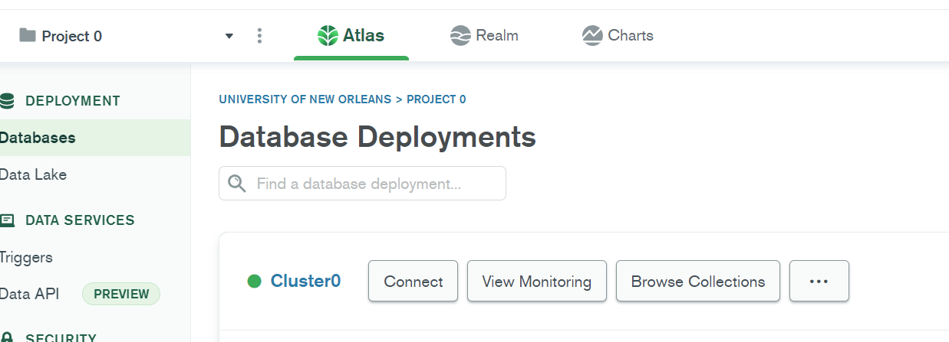

Quick Primer on Express and MongoDB
One other quick thing…
For sanity checking, it will be very convenient that, as you develop your app, to keep your eye on that “Browse Collections” button on your browser tab that has MongoDB open.

Slide 37
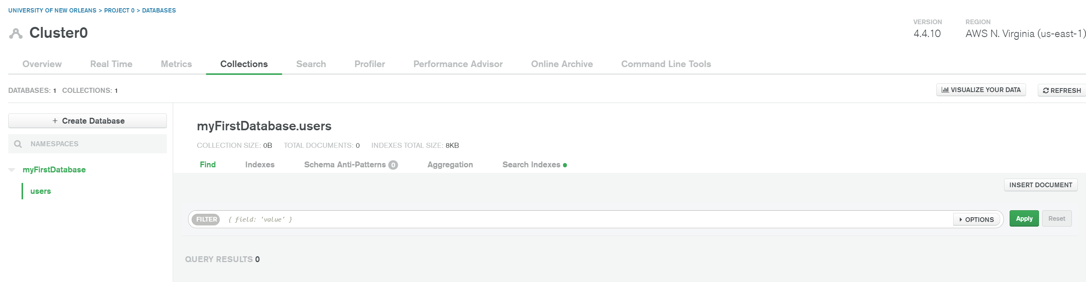
Quick Primer on Express and MongoDB
As we add more things to the database, we’ll see it show up here!
And it’ll be good!

Slide 38
Quick Primer on Express and MongoDB
OK – I know this is going pretty fast, and you probably have some questions as to what all of this “means”
The upshot:
Just like how we used that simple JSON server to set up a server on our computer that could receive requests from our app to update files on our local machine…
Now, we are using Express API to set up a server on our computer that can receive requests from our app to update our mongo database stored in the cloud.

Slide 39
Quick Primer on Express and MongoDB
And if you aren’t understanding every little thing, that’s fine too!
Let’s just be along for the ride!

Slide 40
Today’s Agenda
Quick Primer on Express and MongoDB
Setting Up Our New App
Navigator Hookups
Building the Authentication Screens
The Auth Context

Slide 41


Setting Up Our New App
Screens user sees when not signed in
(authentication screens)
First, let’s do a bit of brainstorming about the screens of our app and how they connect with each other.
SignupScreen
SigninScreen
TrackListScreen
TrackDetailScreen
Screens user sees when signed in.
(NOT authentication screens).
TrackCreateScreen
AccountScreen

Slide 42


Setting Up Our New App
Screens user sees when not signed in
(authentication screens)
Will use Switch Navigator
We’re going to use this as an opportunity to play around with other forms of react navigation.
SignupScreen
SigninScreen
TrackListScreen
TrackDetailScreen
Screens user sees when signed in.
(NOT authentication screens).
Will use Bottom Tab Navigator.
TrackCreateScreen
AccountScreen

Slide 43
Setting Up Our New App
Kind of hard to convey this, but there are some screens that seem to have a traditional “StackNavigator” relationship to one another.
SignupScreen
SigninScreen
StackNavigator
TrackListScreen
TrackDetailScreen
StackNavigator
TrackCreateScreen
AccountScreen

Slide 44
Setting Up Our New App
But in this app, we want some screens to be joined with a bottom tab navigator.
SignupScreen
SigninScreen
StackNavigator
Bottom Tab Navigator
TrackListScreen
TrackDetailScreen
StackNavigator
TrackCreateScreen
AccountScreen

Slide 45
Setting Up Our New App
All that remains is how to get to “auth flow” to “not auth flow” This is a good use case for the Switch Navigator.
SignupScreen
SigninScreen
StackNavigator
Bottom Tab Navigator
TrackListScreen
TrackDetailScreen
StackNavigator
TrackCreateScreen
AccountScreen

Slide 46
Setting Up Our New App
SwitchNavigator
SignupScreen
SigninScreen
StackNavigator
Bottom Tab Navigator
TrackListScreen
TrackDetailScreen
StackNavigator
TrackCreateScreen
AccountScreen

Slide 47
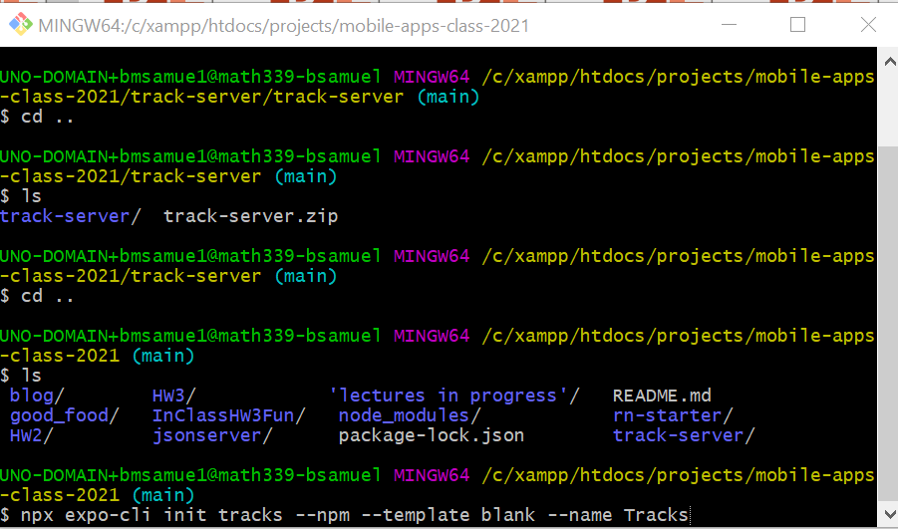
Setting Up Our New App
I bring all of that up because it is going to slightly change some of the things we need to install/set up.
Once again, we open up a new terminal window.
New so that we don’t close down the Express server we just spun up.
We can navigate to a new directory (maybe one “close to” the track-server directory )? And type the following:
npx expo-cli init tracks --npm --template blank --name Tracks

Slide 48
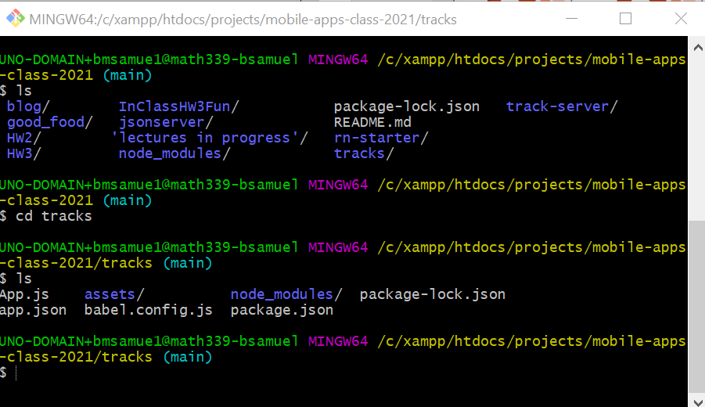
Setting Up Our New App
Change into the new project directory you just created…
cd tracks

Slide 49
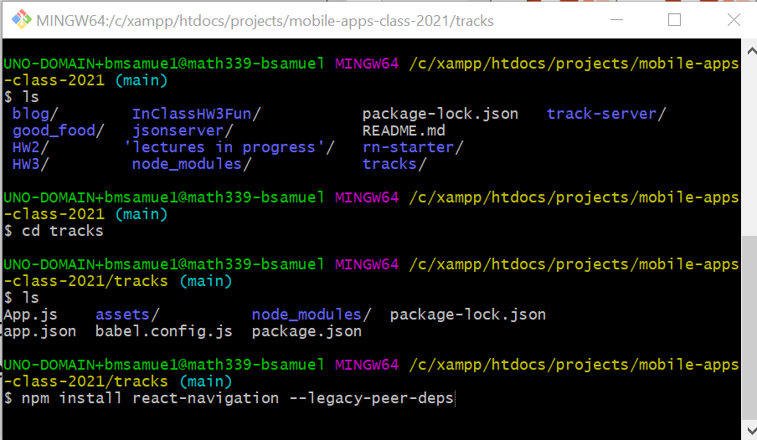
Setting Up Our New App
Then install React Navigation
npm install react-navigation –-legacy-peer-deps

Slide 50
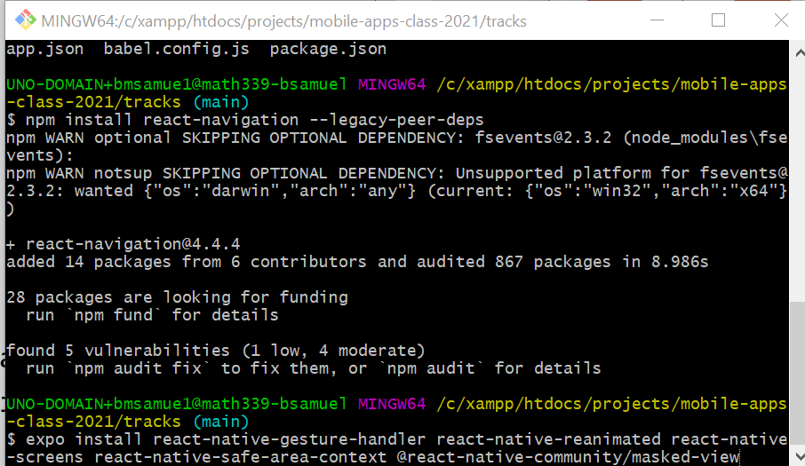
Setting Up Our New App
Then install dependencies
expo install react-native-gesture-handler react-native-reanimated react-native-screens react-native-safe-area-context @react=native-community/masked-view

Slide 51
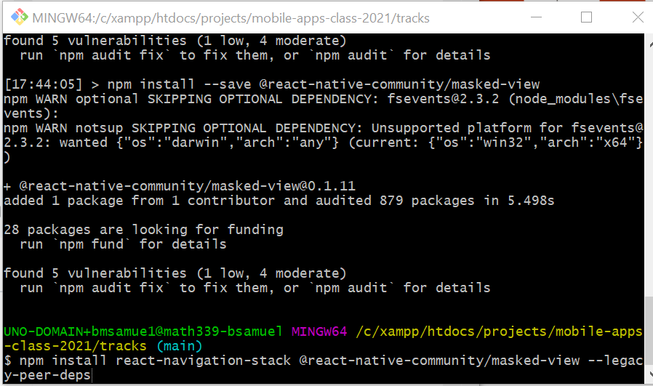
Setting Up Our New App
Then install React Navigation Stack
npm install react-navigation-stack @react-native-community/masked-view –legacy-peer-deps

Slide 52
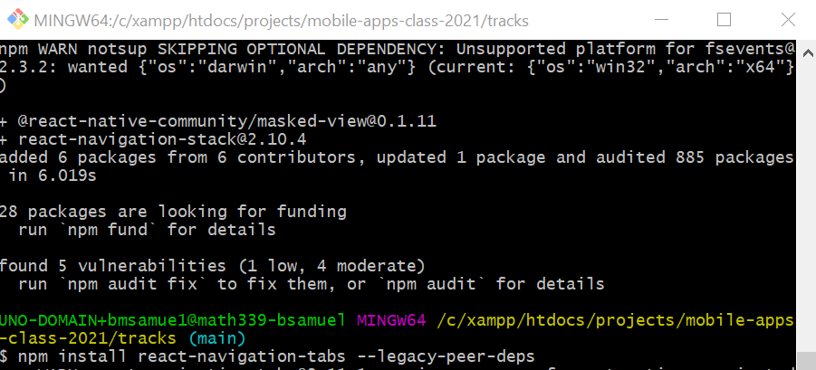
Setting Up Our New App
Then install React Navigation Tabs
npm install react-navigation-tabs –legacy-peer-deps

Slide 53
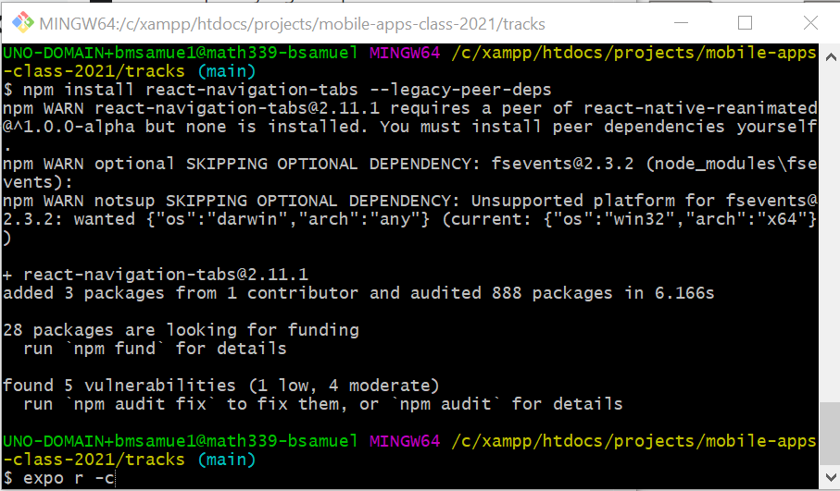
Setting Up Our New App
And then the first time you run the app, do so by clearing the cache with
expo r -c

Slide 54
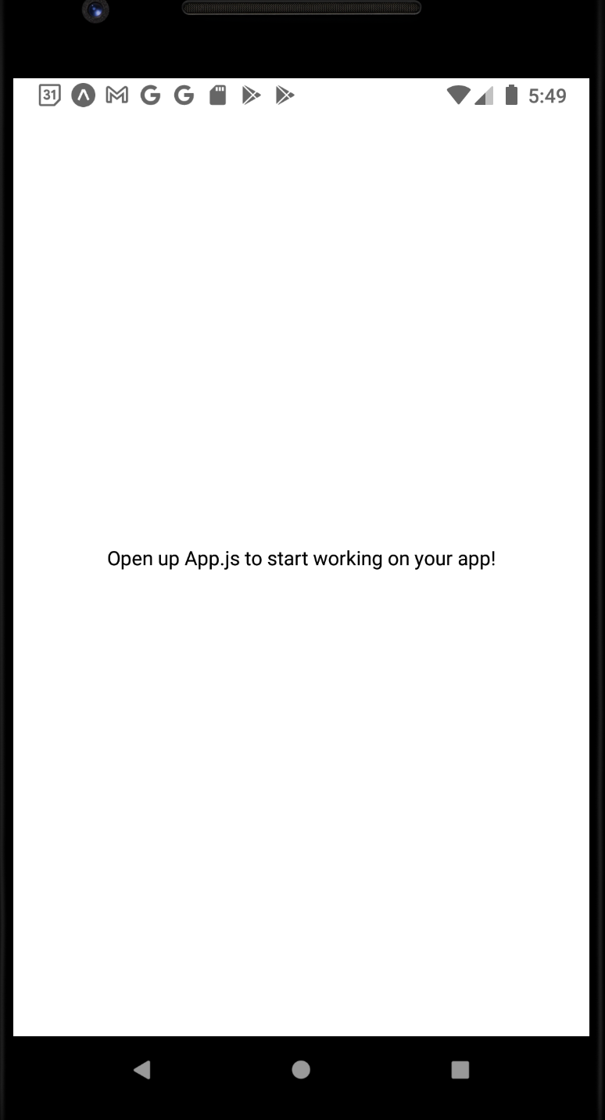
Setting Up Our New App
And then if you scan the QR code / start up the emulator, you should see this familiar screen!
But now we have some extra dependencies in place for our additional forms of navigation!

Slide 55
Setting Up Our New App
SignupScreen
And just as we always do, we need to create some boilerplate code!
Let’s do it slightly differently this time – let’s create ‘empty’ screens for all six of the screens in our project in one go.
This scaffolding will help us stitch all of the navigation together.
SigninScreen
TrackListScreen
TrackDetailScreen
TrackCreateScreen
AccountScreen

Slide 56
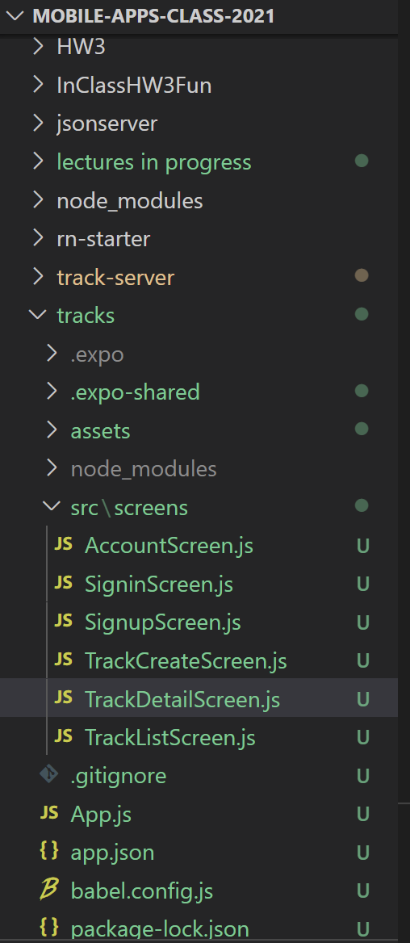
Setting Up Our New App
So again – this is in the NEW PROJECT you just created (“tracks”)
This is *not* in track-server.
Create a new “src” directory, a “screens” directory inside of it, and then six .js files inside of it.

Slide 57
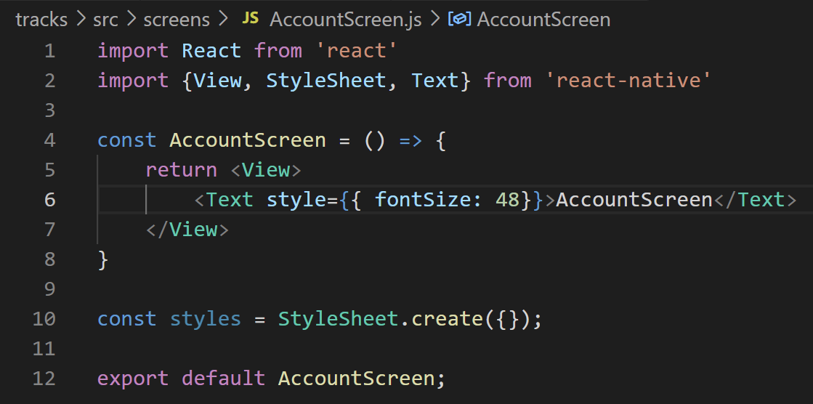
Setting Up Our New App
And then, pick one of the .js files, and fill it up with boiler plate code, as always! Here is my AccountScreen.js file.

Slide 58
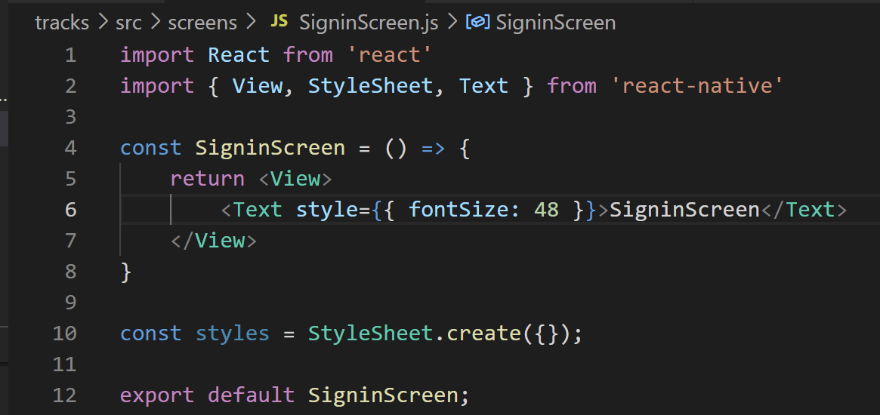
Setting Up Our New App
And you can copy and paste it into the other files too, changing some key values. Here is my SigninScreen.js – I leave it as an exercise to you to do the other four!

Slide 59
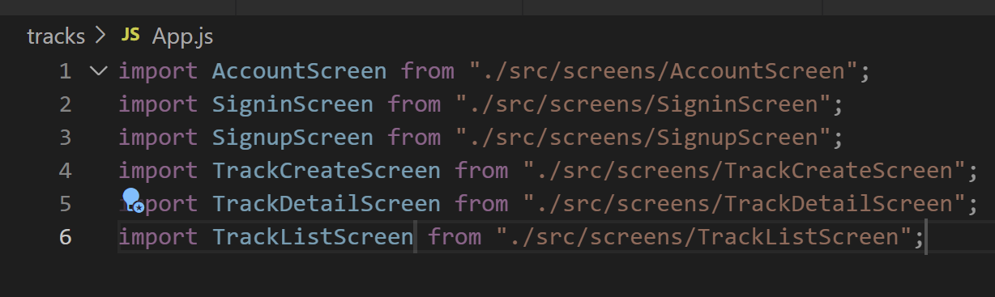
Setting Up Our New App
And then we also need to set up our App.js file.
For now, we’ll just import all of these screen files we just made.
Because before this is where we set up stack navigation… and now we’re going to be doing something slightly fancier!

Slide 60
Today’s Agenda
Quick Primer on Express and MongoDB
Setting Up Our New App
Navigator Hookups
Building the Authentication Screens
The Auth Context

Slide 61
Navigator Hookups
OK! We’ve got all these screens… now let’s try to stitch them together!
SwitchNavigator
SignupScreen
SigninScreen
StackNavigator
Bottom Tab Navigator
TrackListScreen
TrackDetailScreen
StackNavigator
TrackCreateScreen
AccountScreen

Slide 62
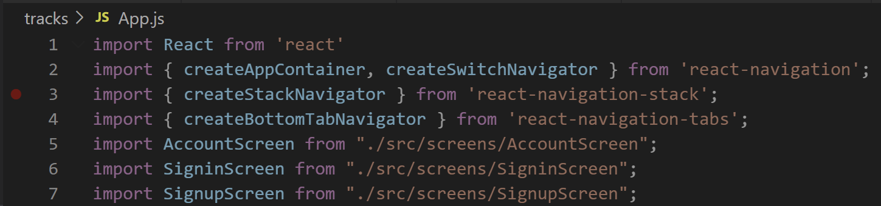
Navigator Hookups
SwitchNavigator
SignupScreen
SigninScreen
StackNavigator
Bottom Tab Navigator
TrackListScreen
TrackDetailScreen
StackNavigator
TrackCreateScreen
AccountScreen
A lot of this is going to take place inside of App.js…
First, let’s import some of the things we’ll need…
We’ve used createAppContainer and createStackNavigator before…
But now we are also import createSwitchNavigator and createBottomTabNavigator

Slide 63
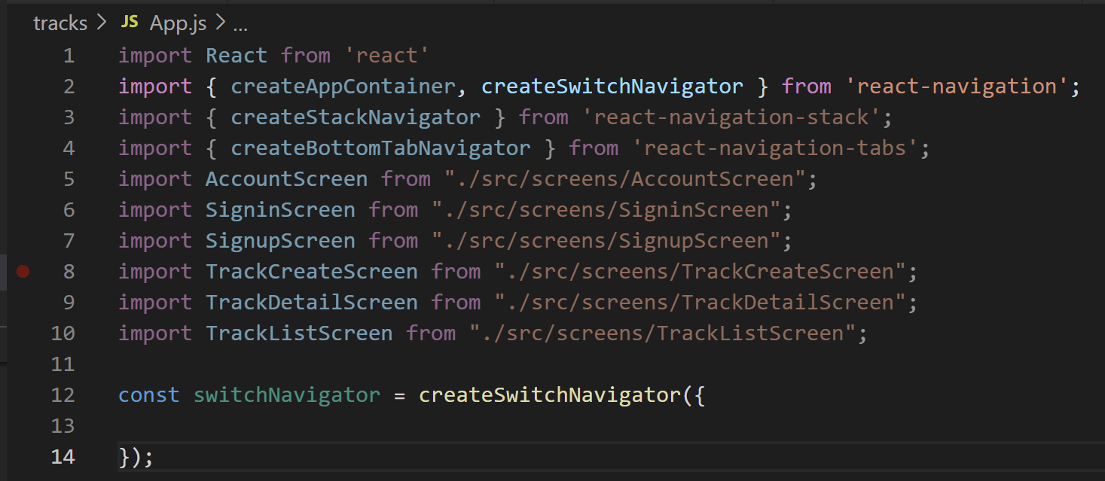
Navigator Hookups
SwitchNavigator
SignupScreen
SigninScreen
StackNavigator
Bottom Tab Navigator
TrackListScreen
TrackDetailScreen
StackNavigator
TrackCreateScreen
AccountScreen
So, when setting up navigation, we kind of have to go from an “outside-in” approach.
We can see in our diagram that the SwitchNavigator is kind of like, the “top” of our hierarchy.
Eventually we’ll have a bunch of nested navigator statements.

Slide 64
Navigator Hookups
SwitchNavigator
SignupScreen
SigninScreen
StackNavigator
Bottom Tab Navigator
TrackListScreen
TrackDetailScreen
StackNavigator
TrackCreateScreen
AccountScreen
Before when we’ve done this, we’ve come up with keys or names that have pointed to the screens that we’ve imported…
But we can come up with keys that point to *OTHER NAVIGATORS* as well!

Slide 65
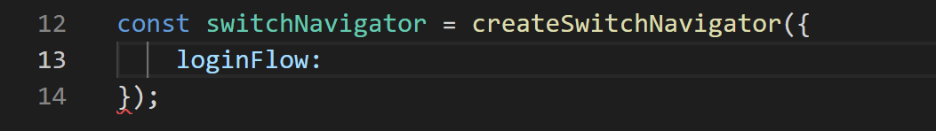
Navigator Hookups
SwitchNavigator
SignupScreen
SigninScreen
StackNavigator
Bottom Tab Navigator
TrackListScreen
TrackDetailScreen
StackNavigator
TrackCreateScreen
AccountScreen
So here, we’ll have the first key be for “loginFlow” to take us to the login or sign up screens.
Specifically, we’ll have it point to a StackNavigator, that will have one of those two screens.

Slide 66
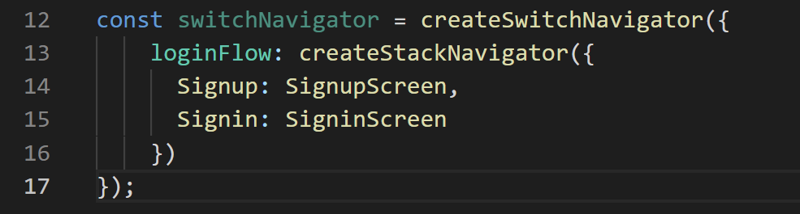
Navigator Hookups
SwitchNavigator
SignupScreen
SigninScreen
StackNavigator
Bottom Tab Navigator
TrackListScreen
TrackDetailScreen
StackNavigator
TrackCreateScreen
AccountScreen
Maybe something like this!
So our StackNavigator that we are creating looks a lot like the stack navigators we’ve created in the past!
Here, each key is pointing at a specific screen that we are importing!

Slide 67
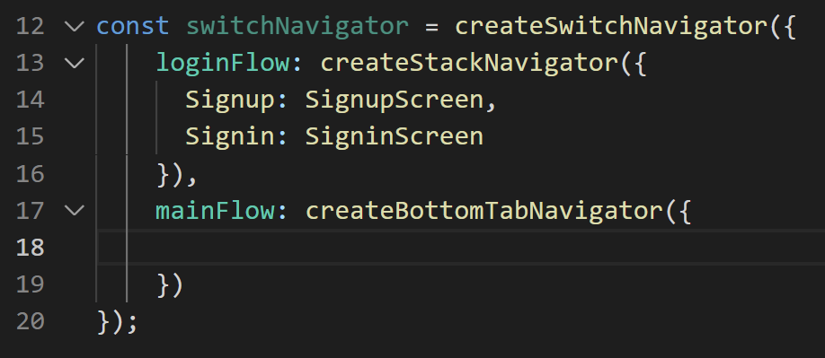
Navigator Hookups
SwitchNavigator
SignupScreen
SigninScreen
StackNavigator
Bottom Tab Navigator
TrackListScreen
TrackDetailScreen
StackNavigator
TrackCreateScreen
AccountScreen
Alternatively, the SwitchNavigator could also take us to the “mainFlow”, i.e., the non-authentication based screens.
And those screens we’ll jump between using a Bottom Tab Navigator.

Slide 68
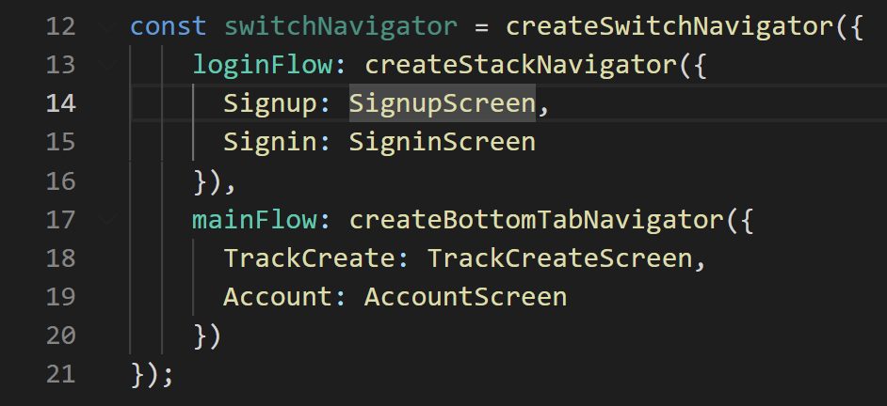
Navigator Hookups
SwitchNavigator
SignupScreen
SigninScreen
StackNavigator
Bottom Tab Navigator
TrackListScreen
TrackDetailScreen
StackNavigator
TrackCreateScreen
AccountScreen
So, the mainFlow begins with that BottomTab navigator, that works with TrackCreate and Account Screens…
But we can see, it also needs to deal with a StackNavigator…

Slide 69
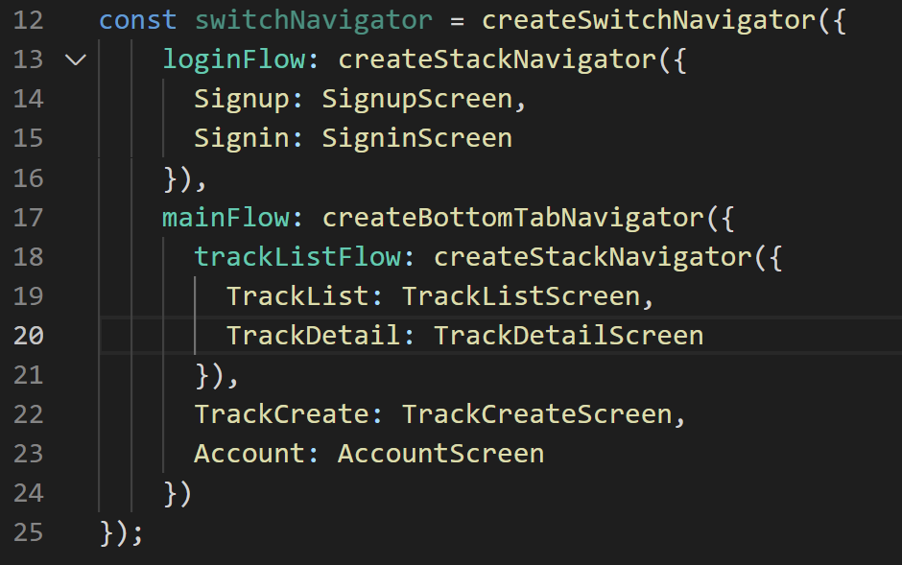
Navigator Hookups
SwitchNavigator
SignupScreen
SigninScreen
StackNavigator
Bottom Tab Navigator
TrackListScreen
TrackDetailScreen
StackNavigator
TrackCreateScreen
AccountScreen
So we add that in!
We have a nested navigator setup! So now, to get something to show up, let’s export our top level navigator.

Slide 70
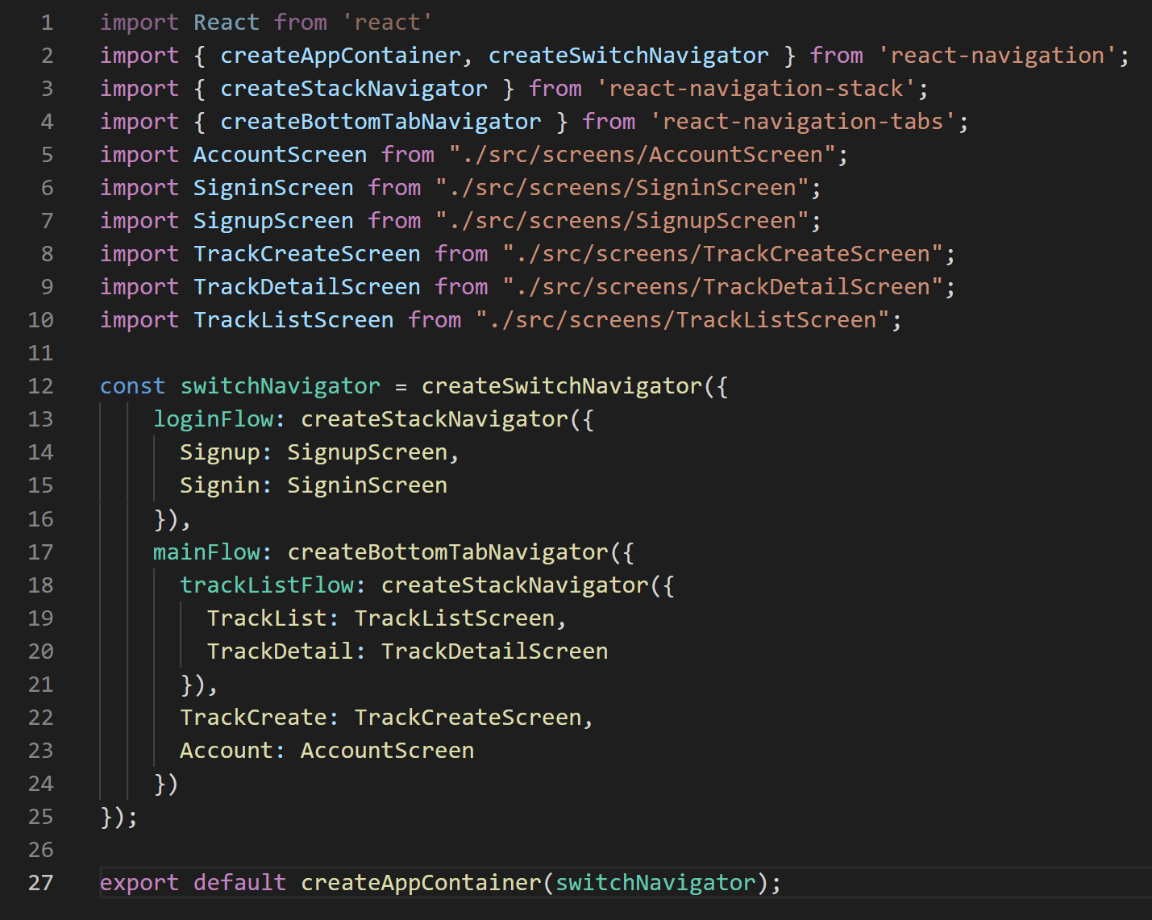
Navigator Hookups
SwitchNavigator
SignupScreen
SigninScreen
StackNavigator
Bottom Tab Navigator
TrackListScreen
TrackDetailScreen
StackNavigator
TrackCreateScreen
AccountScreen
So altogether it looks like this.

Slide 71
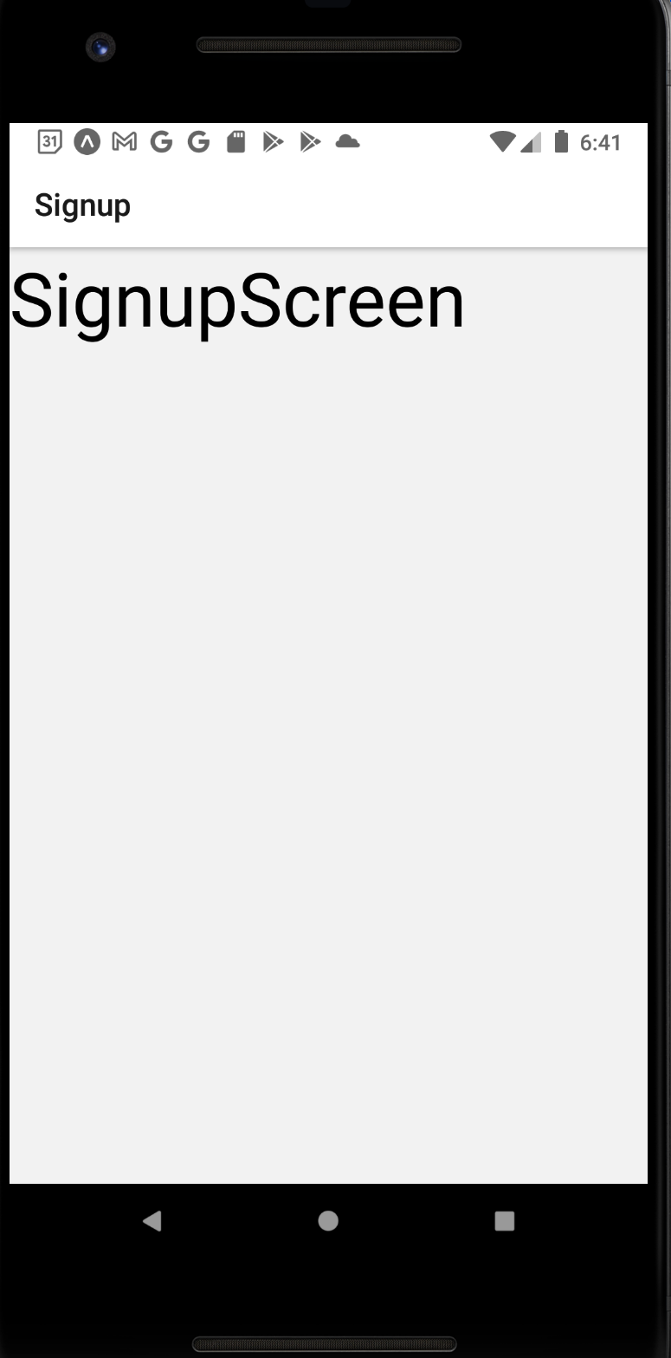
Navigator Hookups
And we don’t actually have any way to get anywhere yet, but at this point, we should be able to see the first screen, Signup.
Before we get too crazy with our app, let’s just test the navigation flow quickly…
Just by adding some buttons to each screen…

Slide 72
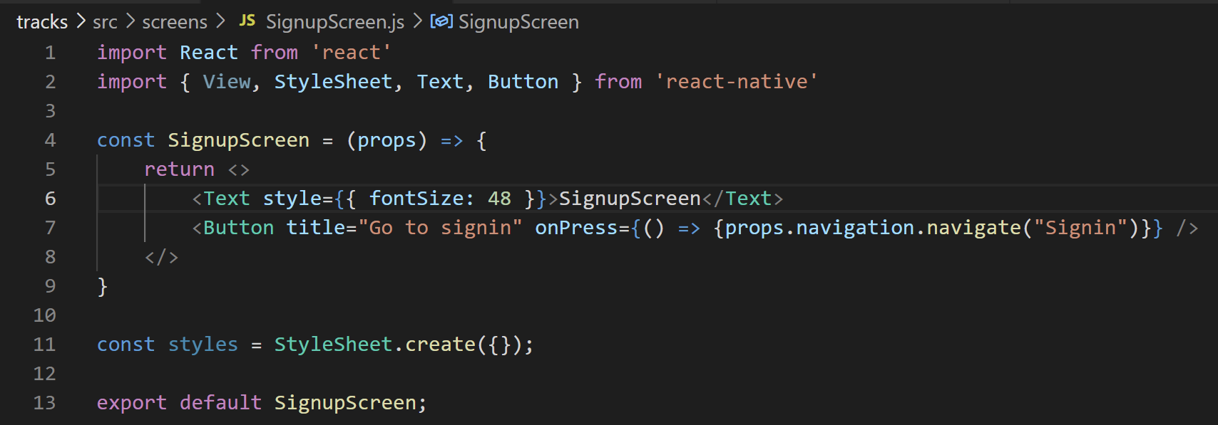
Navigator Hookups
So first we have this on the Signup Sheet. I made a few quick changes…
Imported Button..
Using the empty component (aka a “fragment”)…
Importing props…
Created a Button…
Have clicking on the button navigate you to the Signin route.

Slide 73
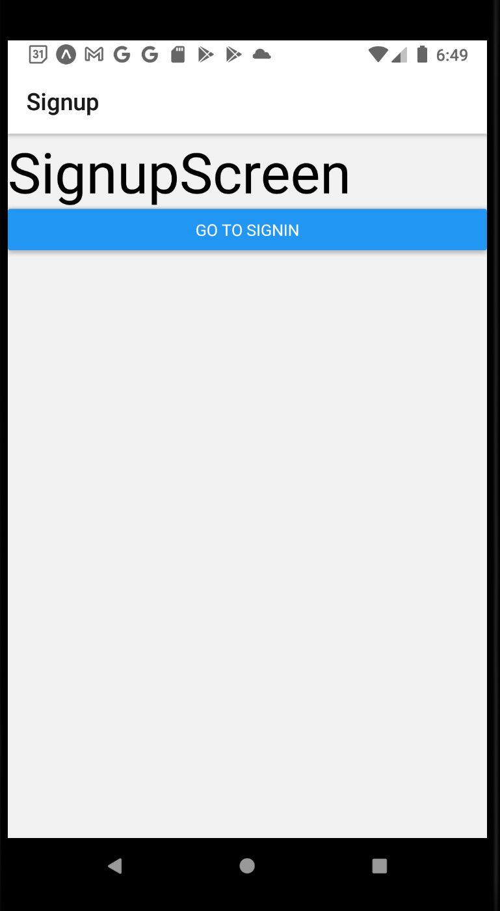
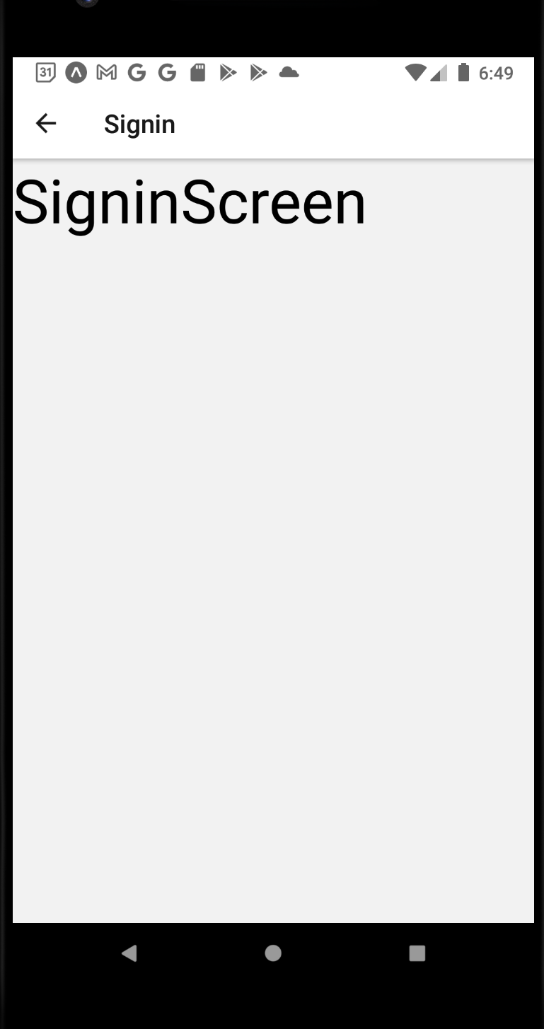
Navigator Hookups
And indeed, we now have the means to go back and forth between signup and signin.
Now let’s add a new button to simulate actually signing in and going to our main flow.

Slide 74

Navigator Hookups
So maybe something like this!
Remember, “mainFlow” was what we called the BottomTabNavigator, and all of the screens that it contains!
Which screen do you think it will take us to?

Slide 75



Navigator Hookups
It takes us to TrackList!
And check out that lovely bottom tab navigator that was automatically created for us!
And that we DON’T have a “back” button. That’s a stack navigator thing – but we’re in tab navigation land now!

Slide 76


Navigator Hookups
And by clicking on all of them, we can jump back and forth between them quickly and easily!

Slide 77
Navigator Hookups
The last bit of “flow” to test is for us to be able to visit a “Track Detail” from the Track List screen.
For now, we’ll simulate that with another button.

Slide 78

Navigator Hookups
So the TrackListScreen.js file might look something like this...df
Include props…
import button.
make use of button…
navigate to TrackDetail.

Slide 79


Navigator Hookups
And it does indeed have a button that takes us to the detail screen!
And don’t forget, this inner one IS a stack navigator… so our back button returns!

Slide 80
Navigator Hookups
And look at that!
Clearly there’s still a lot of content missing!
But in just a few minutes, we were able to get the complete flow of our app implemented.
Pretty darn cool!

Slide 81
Today’s Agenda
Quick Primer on Express and MongoDB
Setting Up Our New App
Navigator Hookups
Building the Authentication Screens
The Auth Context

Slide 82

Authentication Screens
So, we’ve all seen authentication screens before... we probably know generally what they look like, yeah?
And like – we’ve MADE stuff like this from scratch! With Text fields and TextInput components and all that jazz.

Slide 83
Authentication Screens
Now that said… ah… there is another library called
“react-native-elements”
That we can leverage that has a lot of pre-built commonly used components. We’ll need to install it to use it, but it potentially might save us some time in the long run.

Slide 84

Authentication Screens
To install it…
I would first quit out of metro bundler
Might just be me being superstitious…
And then in your project directory, type:
npm install react-native-elements

Slide 85


Authentication Screens
If you check out the documentation
You’ll see that some of the components have names you are familiar with.
Like Button.

Slide 86

Authentication Screens
Remember: Button only exists because people felt that “TouchableOpacity” wasn’t an intuitive name.
So the react native button has very little styling capability.
BUT the react native elements buttons CAN be customized.

Slide 87

Authentication Screens
If you scroll down, you can see “Usage” examples, and also a list of props you can provide it with.
And you can all of a sudden start making use of fancy pants buttons!

Slide 88

Authentication Screens
We can also see that we can make use of react native elements version of Text to get some nicely, easily configurable bit of text!
Giving it props akin to HTML header tags to affect the size!

Slide 89

Authentication Screens
Input, as well, affords some nice customization options for us to make use of too!

Slide 90
Authentication Screens
So, by leveraging this stuff, we can start to do some pretty nifty things!
Let’s get to it! Let’s make a sign-in page!

Slide 91

Authentication Screens
So inside of SignupScreen.js – we can import some things from react-native-elements.
Note that I am now no longer importing Text and Button from react-native, to avoid namespace confusion.

Slide 92

Authentication Screens
And now we make use of them!
The h3 prop inside of the Text component will make it appear fairly large.
The label prop inside of Input will make a little note by where we type in the input to let the user know what is expected.
And now we’re using a “fancy” Button (that will right now still look much the same).

Slide 93

Authentication Screens
And check that out! Pretty cool!
Now, it doesn’t necessarily look THAT great – we can fix that by adding some margin and padding ourselves. Just so that everything lines itself up on the screen a little more nicely.
And we’re going to do that in kind of a new way! Through a reusable component!

Slide 94

Authentication Screens
I created a new Components folder inside of src…
And inside of that, created this file, Spacer.js
It’s pretty barebones as you can see.

Slide 95
Authentication Screens
It does, however, make use of a trick that we briefly saw once before…
It takes in the “children” (i.e., the components that are nested within it)…
And it essentially wraps them in a View that has a margin of 15.

Slide 96


Authentication Screens
And now inside of Signup, we can make use of Spacer, both by wrapping other components inside of it…
And just by using it by itself…
As a means of giving a margin of 15 to various things.

Slide 97

Authentication Screens
Which ultimately makes this look a lot nicer!
Now, you might make the argument that using the stylesheet like we’ve used to do would have been just as good/better.
And, eh, yeah, maybe.
BUT – this is a very nice way to get some universally similar styling across our entire application!
Since every screen is going to be able to import and make use of this.

Slide 98

Authentication Screens
Now – since we’re spending so much time fussing over navigaton details…
Let’s get rid of this header.
It’s there because technically this part of a stack navigator with the Signin screen – but we don’t really want the header there.
We can also try to vertically center our content.

Slide 99


Authentication Screens
We’ve done things like this before (when adding an icon to our blog app to navigate us to another screen).
The navigationOptions allows us to do some customization.
This is how you make the header go away.

Slide 100

Authentication Screens
However, without the header, the text kind of jams up against the top of the screen.
We can address this by addressing the fragment (the <>).
We are in fact going to change it back to a View, to apply styling to it.

Slide 101


Authentication Screens
And give it some quick styling.
A giant red border.
Which at present shows our View is only as big as its content.

Slide 102


Authentication Screens
If we also give the view a flex of 1…
We’ll see it now expands to use as much space as possible.

Slide 103


Authentication Screens
And now if we tell our view to justify its content to the center…
We can see that everything is now vertically centered!
At least, supposedly… it still kinda FEELS like there’s a lot of empty space along the top, right?

Slide 104


Authentication Screens
A cool trick: give the View a margin bottom.
This reduces the total amount of vertical space it has available.
And thus brings the content closer to the top.

Slide 105
Authentication Screens
At this point you can also get rid of the red border, if you so wish.
Visually the form is looking pretty OK! Let’s give it some functionality to go with it!
The first step is pretty simple: it’s what we’ve been doing before with Inputs. Hooking it up with the react native state system.

Slide 106


Authentication Screens
We set up state variables that the Inputs update when they get text entered into them…
We add in props to take away the text automatically changing…
This one is new – secureTextEntry makes it so that passwords don’t appear is plain text.

Slide 107
Authentication Screens
So all of this is pretty easy…
The interesting new part… is figuring out what we want to do with this data AFTER it’s been typed in and the button gets pushed…

Slide 108
Today’s Agenda
Quick Primer on Express and MongoDB
Setting Up Our New App
Navigator Hookups
Building the Authentication Screens
The Auth Context

Slide 109
The Auth Context
So all of this is pretty easy…
The interesting new part… is figuring out what we want to do with this data AFTER it’s been typed in and the button gets pushed…
This is a big question and has a lot of moving parts to it…
But the one that we’ll start with: we’ll make use of the Context system and create a new Provider!

Slide 110
The Auth Context
We’ll create an Auth provider, to basically store information pertaining to if the user is logged in or not.
Remember: the beauty of providers is that the data they store can be used anywhere in your app!
AuthProvider
{isSignedIn: true}
Navigation Components
SigninScreen
SignupScreen
TrackListScreen
TrackCreateScreen
AccountScreen
TrackDetailScreen

Slide 111

The Auth Context
We’re going to go about this in the same way that we did last time!
That is, making a nifty function that will create new Context objects for us!
Inside of src, make a new context folder…
And inside of that, create a new file called createDataContext.js
This will be very similar to what we made last time.

Slide 112

The Auth Context
Recall, the beauty of this code is that it is completely generic
Which means that if you already had this from before, you COULD just copy and paste it into this new project.

Slide 113

The Auth Context
The magic now happens inside of a new file, AuthContext.js
Wherein we actually define the reducer function, all of the actions, and the default state.
We’ll start by importing the function we just wrote, and starting off our reducer function.
Right now we’ll just give it the default action as a starting point: don’t change anything.

Slide 114

The Auth Context
Likewise, we can worry about the actions later as well!
And for the starting state, we’ll have a flag saying that the user isn’t signed in.
If time permits we’ll flesh that out a little more, but this is a good starting point.
And just like that, we have a first pass at this! We can pass in these things to our function.
And then export the Provider and Context that the function returns.

Slide 115


The Auth Context
And don’t forget – you need to add this inside of App.js if you want to make use of this.
We import it (giving it a special name, since we might very well have multiple Contexts for this app).
And then we return a new custom component, that wraps our navigator inside of our provider.

Slide 116
The Auth Context
And with that, it’s all set up!
There’s more work to do of course – we haven’t really thought about all of the different types of state the provider needs to maintain…
And how to change them…
But we are still off to a really good start!
We just need to figure out what it is that the AuthProvider is actually doing.

Slide 117
The Auth Context
Well… if we give ourselves a bird’s eye view once again…
Where are the places where our “authentication state” is likely to change?
AuthProvider
{isSignedIn: true}
Navigation Components
SigninScreen
SignupScreen
TrackListScreen
TrackCreateScreen
AccountScreen
TrackDetailScreen

Slide 118
The Auth Context
One is the signIn screen!
The sign in screen will, try to “sign in”, to change signedIn to true!
“Try to sign in”
{email: ‘asdf’,
password: ‘asdf’}
AuthProvider
{isSignedIn: true}
Navigation Components
SigninScreen
SignupScreen
TrackListScreen
TrackCreateScreen
AccountScreen
TrackDetailScreen

Slide 119
The Auth Context
The sign up screen will too, basically. Behind the scenes signing up is a little different from signing in…
But both of them will end up having the affect of them being signed in!
“Try to sign in”
{email: ‘asdf’,
password: ‘asdf’}
AuthProvider
{isSignedIn: true}
“Try to sign up”
{email: ‘asdf’,
password: ‘asdf’}
Navigation Components
SigninScreen
SignupScreen
TrackListScreen
TrackCreateScreen
AccountScreen
TrackDetailScreen

Slide 120
The Auth Context
And I’m going to say that the AccountScreen has a “signout” button.
And you don’t really need any extra data in order to sign out.
“Try to sign in”
{email: ‘asdf’,
password: ‘asdf’}
AuthProvider
{isSignedIn: true}
“Try to sign out”
“Try to sign up”
{email: ‘asdf’,
password: ‘asdf’}
Navigation Components
SigninScreen
SignupScreen
TrackListScreen
TrackCreateScreen
AccountScreen
TrackDetailScreen

Slide 121
The Auth Context
So it is the responsibility of the provider to receive these signals, and to affect the state based on these signals.
Now we can try to create action functions inside of our AuthContext file!
“Try to sign in”
{email: ‘asdf’,
password: ‘asdf’}
AuthProvider
{isSignedIn: true}
“Try to sign out”
“Try to sign up”
{email: ‘asdf’,
password: ‘asdf’}
Navigation Components
SigninScreen
SignupScreen
TrackListScreen
TrackCreateScreen
AccountScreen
TrackDetailScreen

Slide 122

The Auth Context
We can begin creating the first action function here: signup.
We’ll expect to receive an object that has the email and password data that the user provided.

Slide 123
The Auth Context
And you can see in the comments, the general flow of what this function will need to do.

Slide 124

The Auth Context
We can stub out signin as well – at a high level, it is doing very similar work to signup!

Slide 125

The Auth Context
signout is much easier!
Doesn’t require any data!
And in theory has no chance of failure!
At least not because they provide faulty data, etc.

Slide 126

The Auth Context
And then, don’t forget, you need to actually pass these functions into your call to createDataContext

Slide 127

The Auth Context
OK – it seems like a lot of these actions depend on making these api requests.
Let’s make these API requests in the same way that we’ve been doing it!
Let’s use Axios!
Which involves installing it and setting it up!

Slide 128
The Auth Context
So yes! Begin with an
npm install axios
In your project directory

Slide 129


The Auth Context
And just as before, we’ll make a new folder called api
And inside of that, a new file, tracker.js
This will help us make an instance of axios that will enable us to make requests of our custom API

Slide 130

The Auth Context
And create our axios instance!
Now – what should go inside of baseURL here?
WELL… we’re going to use ngrok again.
Pros:
Free!
Relatively simple to setup!
Cons:
Ngrok and the Express API server need to be running on our machines at all times.
The ngrok URL that gets created changes every 8ish hours (unless we pay for ngrok).
Which means we might have to go back inside of baseURL and update it!

Slide 131

The Auth Context
In theory, we installed ngrok globally, so we shouldn’t have to reinstall it again for this project.
You can try typing ngrok into your terminal and seeing if it recognizes the command.
If not, try installing it with the command
npm install –g ngrok

Slide 132

The Auth Context
So remember: at this point, we start juggling lots of different terminal windows!
One window for your metro bundler.
One window for your Express API server.
One window for ngrok
Which can’t be git bash, at least for me. Try windows power shell!
On the terminal, write ngrok http 3000
Assuming your expressAPI is running on port 3000.

Slide 133


The Auth Context
You can see what port your express API is on on whatever terminal window you used to start it up.
Here it says 3000!

Slide 134

The Auth Context
And remember – ngrok is going to be unhappy if you run it on UNO secure.
But a “hilarious” workaround is to connect your machine to your phone’s wifi hotspot.
If successful, you should have a window that looks like this pop up.

Slide 135

The Auth Context
And here is the address that we can add as the base URL for our axios instance!

Slide 136

The Auth Context
If you want, you can verify that this is working by just putting this URL into your browser!
And you should see something that looks like this!

Slide 137


The Auth Context
That’s coming from the Express API code that was just handed to you!
In the Index.js file of the track-server code, there is this default route, that makes use of requireAuth…
Which returns this very error message if there is a problem!

Slide 138
The Auth Context
And that, at this cliff hanger moment, is the end of Part 1!
Tune in next time when we actually use our new axios instance to make an API call!

